Slide 1
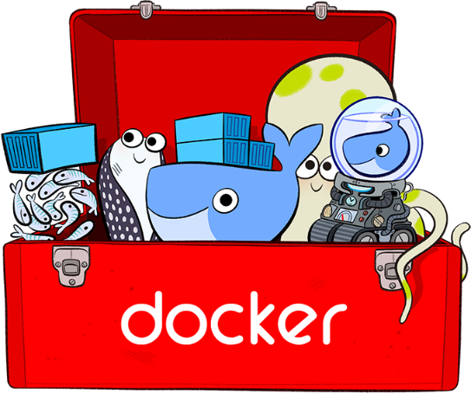
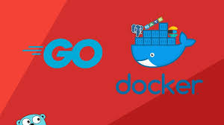
DOCKER

Slide 2
Prerequisites
Linux commands
Development knowledge
Docker Hub account
AWS Account

Slide 3
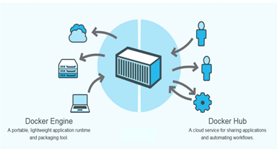
Docker
Wikipedia defines Docker as an open-source project that automates the deployment of software applications inside containers by providing an additional layer of abstraction and automation of OS-level virtualization on Linux.
Notes:
Docker is a tool that allows developers, sys-admins etc. to easily deploy their applications in a sandbox (called containers) to run on the host operating system i.e. Linux.
Docker is a platform for packaging, deploying, and running applications.
Unlike virtual machines, containers do not have the high overhead

Slide 4
Hypervisor-based Virtualization
• One physical server can contain multiple applications
• Each application runs in a virtual machine (VM)
Advantages:
Better resource pooling − One physical machine divided into multiple virtual machines
Limitations:
Each VM stills requires − CPU allocation − Storage − RAM
The more VM’s you run, the more resources you need
Guest OS means wasted resources
Application portability not guaranteed
Notes:
The guest OS is either part of a partitioned system or part of a virtual machine (VM) setup. A guest OS provides an alternative OS for a device.
n VM setups, a guest OS is delivered through a virtual machine environment through a tool called a hypervisor.
Again, the machine will typically have a host OS, where the guest OS will operate "within" the host OS. This can lead to limitations on file saving and other operations within the guest OS, depending on whether the guest OS is said to be "persistent."

Slide 5
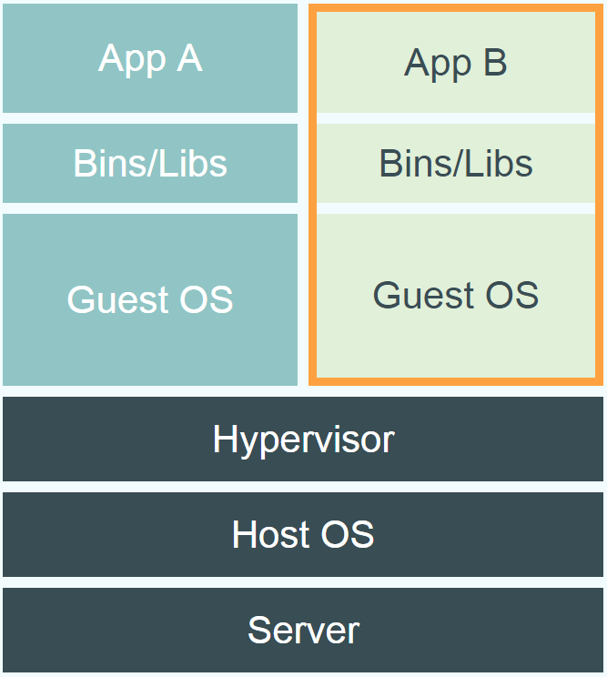
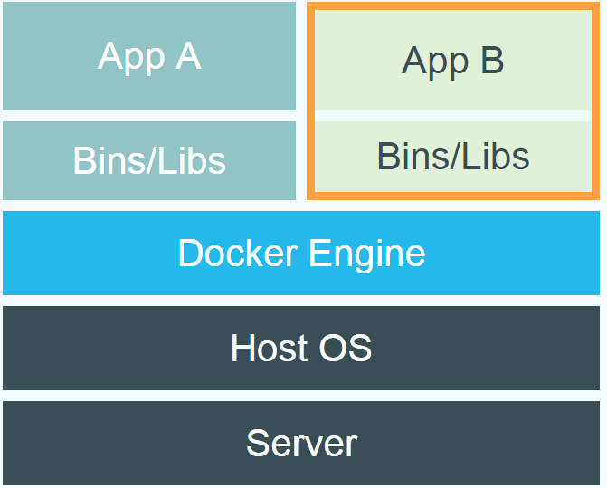
Docker vs. Virtual Machine
Hypervisor-based Virtualization
Docker containers don’t run in their own virtual machines, but share a Linux kernel.
Docker is that it allows users to package an application with all of its dependencies into a standardized unit for software development.
Source: https://www.docker.com/whatisdocker/
Notes:
Compared to virtual machines, containers use less memory and less CPU.
However, a Linux runtime is required for Docker.
• Greater portability
• Containers are easy to manage as they share a common OS − Share multiple workloads on a single OS
• Less CPU, RAM, storage space required
Docker packages applications as images that contain everything needed to run them: code, runtime environment, libraries, and configuration. head and hence enable more efficient usage of the underlying system and resources.

Slide 6
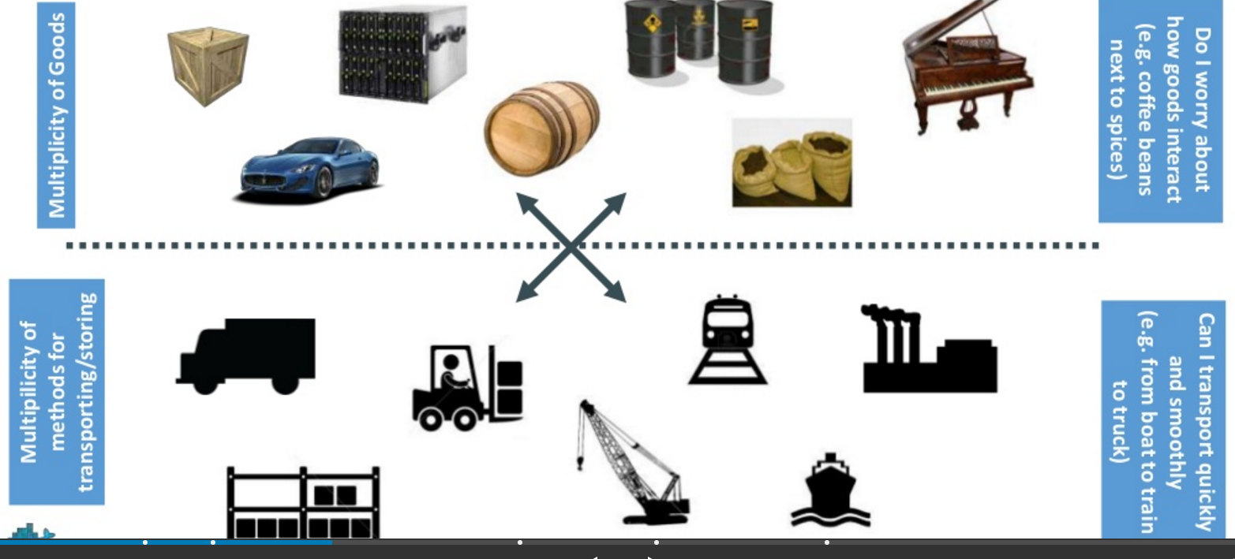
What is container?

Slide 7
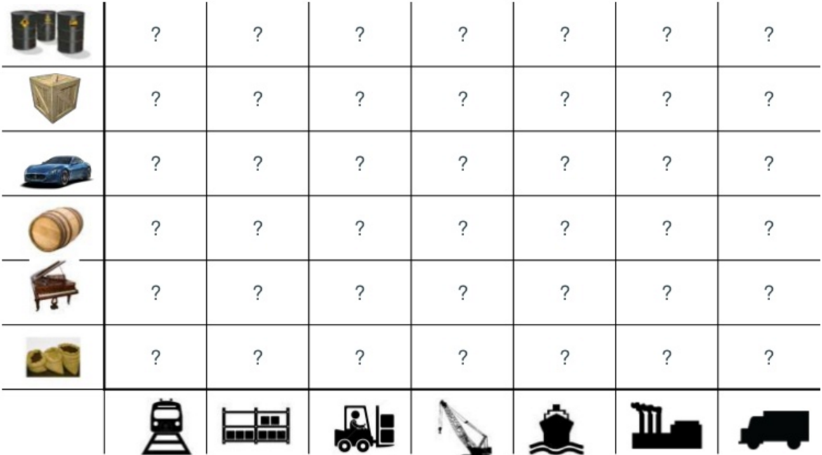
What are the possibilities

Slide 8
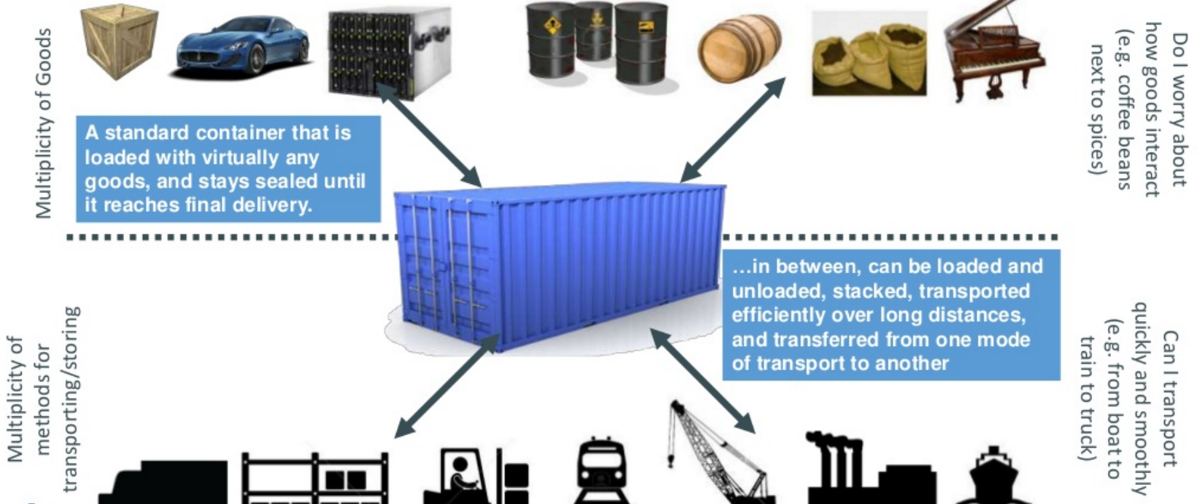
SOLUTION—shipping containers

Slide 9
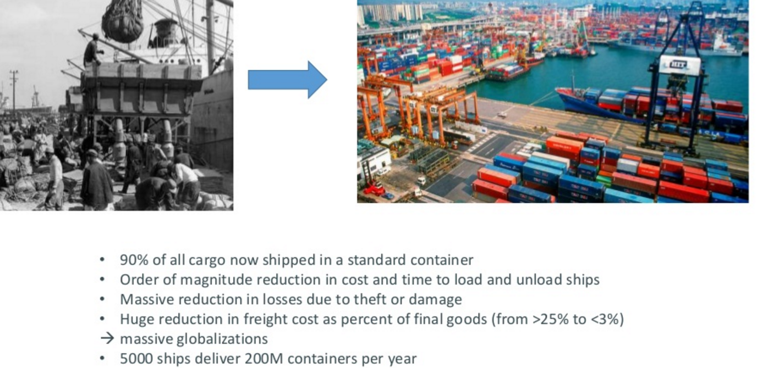
Today’s Shipping…

Slide 10
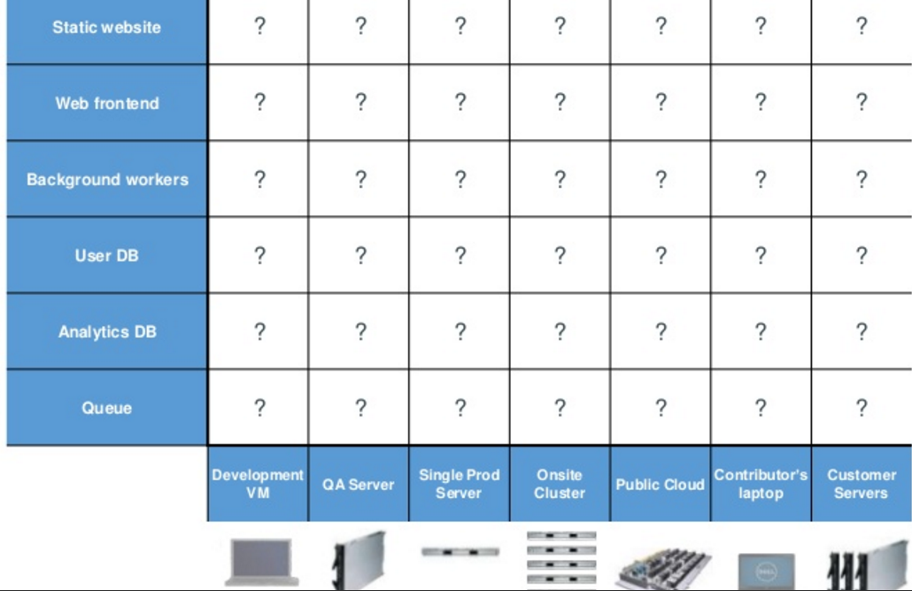
How does this container idea translate to our problem

Slide 11
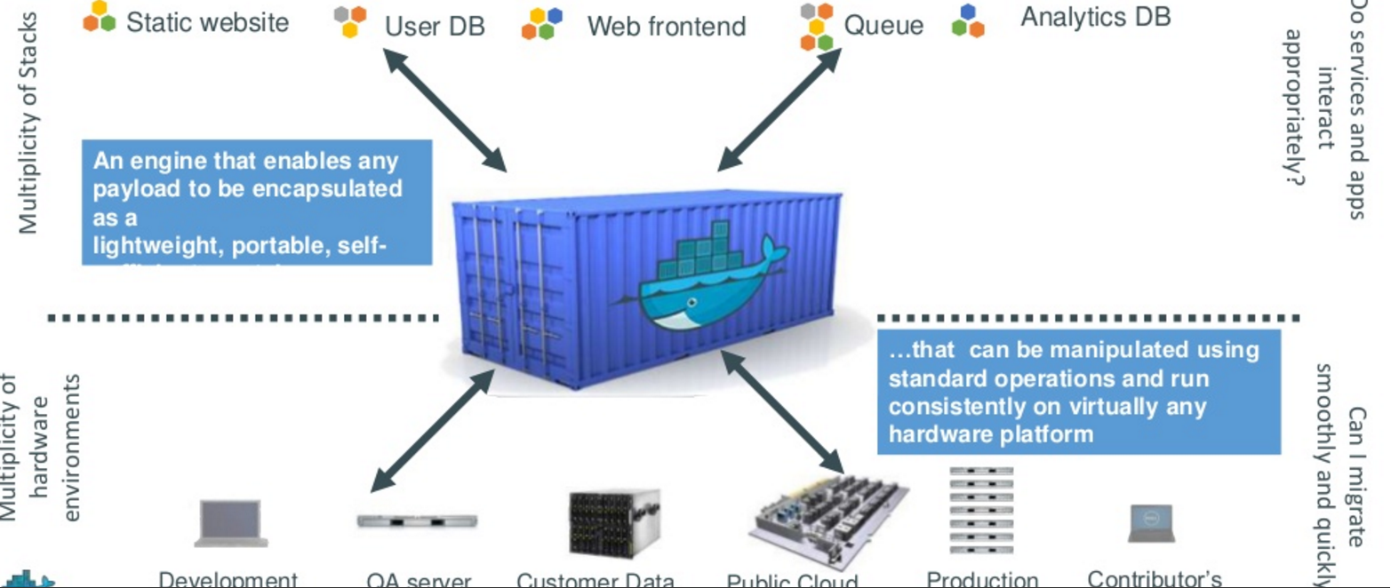
How does this container idea translate to our problem—container for code????
SOLUTION: Do(BUILD) once run anywhere

Slide 12
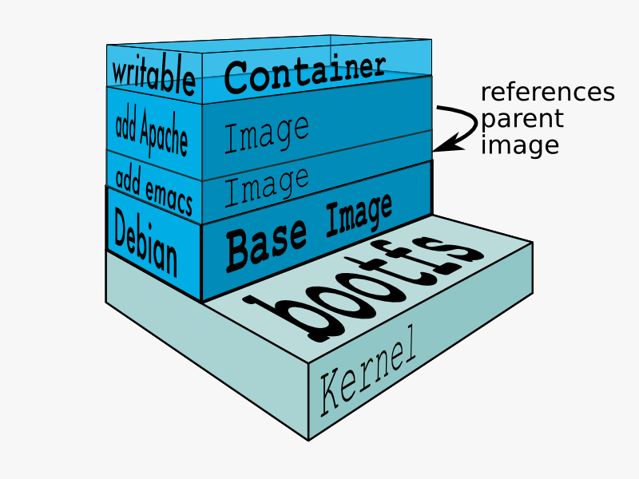
Containers
Containers virtualize the OS just like hypervisors virtualizes the hardware
Containers are lightweight, Portable self-sufficient
Wraps up a piece of software in a complete filesystem that contains everything it needs to run such as : code, runtime, system tools, libraries etc., they share the OS kernel and bins/libs where needed, otherwise each of them operate in a self contained environment.
[Source: https://docs.docker.com/terms/layer/]
Notes:
Containers enable any payload to be encapsulated as a lightweight, Portable self-sufficient container, that can be manipulated using standard operations and run consistently on any hardware platform.
Containers offer logical packaging mechanism in which applications can be abstracted from the environment in which they actually run.
This decoupling allows container-based applications to be deployed easily and consistently, regardless of whether the target environment is a private data center, the public cloud, or even a developer’s personal laptop. This gives developers the ability to create predictable environments that are isolated from rest of the applications and can be run anywhere.

Slide 13
Installation of Docker
We can do installation using following steps
1. https://store.docker.com/editions/community/docker-ce-desktop-windows
The above works only if its Window pro version
2. if other versions, go for docker toolbox
https://download.docker.com/win/stable/DockerToolbox.exe
3. https://docs.docker.com/v17.12/install/#supported-platforms

Slide 14
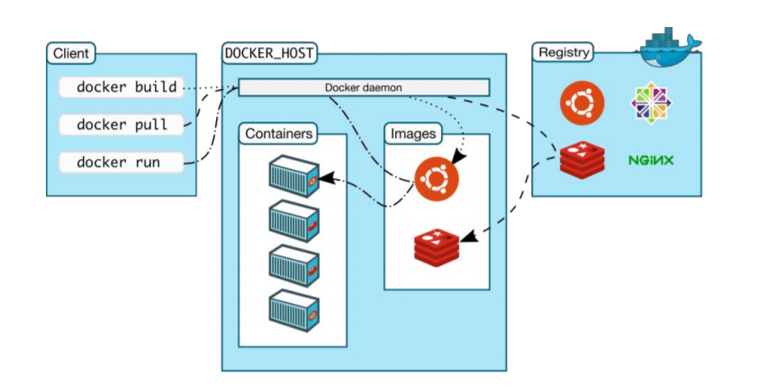
Docker Commands
docker run hello-world - prints “Hello from Docker. This message shows that your installation appears to be working correctly. ...”
Images are pulled
from repositories
Notes:
Docker client provides cli only, it is just an http api wrapper, Like aws cli.
Docker daemon is the brain behind the whole operation, like aws itself. When you use docker runcommand to start up a container, your docker client will translate that command into http API call, sends it to docker daemon, Docker daemon then evaluates the request, talks to underlying os and provisions your container.
Please note docker cli can connect to remote docker daemon, and your can configure your docker daemon to use tcp IP.

Slide 15
Docker Run command
Docker run image-name
Eg : docker run hello-world
Docker run busy-box
docker run ubuntu:14.04 echo “hello world”

Slide 16
Docker Images command
In Docker, everything is based on Images. An image is a combination of a file system and parameters. Let’s take an example of the following command in Docker.
Use command
Docker images
Each image has the following attributes −
TAG − This is used to logically tag images.
Image ID − This is used to uniquely identify the image.
Created − The number of days since the image was created.
Virtual Size − The size of the image.
Removing docker images:
Docker rmi image-id

Slide 17
Basic commands
Docker version – find out the version of docker Engine and client
Docker info – informations about how many containers we have and how many are in running state, virtual box etc.
Docker pull alpine or busy
This command is used for pulling the images from repository
docker ps – is used for finding out all currently running containers
docker ps –a –> is used for finding out all currently running containers + stopped ones too
Docker images –q → used to get only image id of all images, instead of all attributes
Docker inspect image-name → gets some info about images
Docker history image-name → Image ID for which you want to see all the commands that were run against it
Docker stop →stops a running container
Docker rm container-id →sremoves the container with given id
Docker stats → statistics of given container
Docker attach , pause,unpause & kill

Slide 18
Create Your Own Images
We can create our own images by using
docker build -t simple:1.1 .
Where – t states → run as foreground service
Simple → is name of the image
1.1 → is versioning
And important one in the command is usage of ‘.’, means include everything in the given application
-f can also be used to specify can be used to specify a different Dockerfile location

Slide 19
Creating a Docker file
The Dockerfile
A Dockerfile is a configuration file that allows us to specify instructions on how to build an image
It enables configuration as code
# Dockerfile for myapp FROM ubuntu:14.04 RUN apt-get update && apt-get install -y \ curl \ vim
Notes:
FROM creates a layer from the ubuntu:15.04 Docker image.
COPY adds files from your Docker client’s current directory.
RUN builds your application with make.
CMD specifies what command to run within the container.

Slide 20
Image vs. Container
Base Image
busybox:latest
run
Container
cid1
base image
cmd → new state
New Image
iid1
commit
Container
cid1
run
Container
cid2
Container
cid3
Container
cid4

Slide 21
Kitematic
● GUI for Docker
● Start and stop containers
● Connects to Docker Hub to access your images

Slide 23
Thank You.

